Slide 1
BLACK LIVES MATTER
A Movement against rasicm towards black

Slide 2
TABLE OF CONTENTS
01
02
03
04
Introduction
History
Analysis
Conclusion
About Black Lives Matter Movement
How it all started?
How to prevent it?
Comparison between opportunities off white and Black people

Slide 3
01
introduction
About Black Lives Matter Movement

Slide 4
objectives
By the end of this presentation we can understand about:
BML movement
Impact of racism on black people
Reasons for racism
Prevention of racism

Slide 5
What is blm?
The name Black Lives Matter signals condemnation of the unjust killings of Black people by police
Black people are far more likely to be killed by police in the United States than white people
Society should value the lives and humanity of Black people as much as it values the lives and humanity of white people

Slide 6
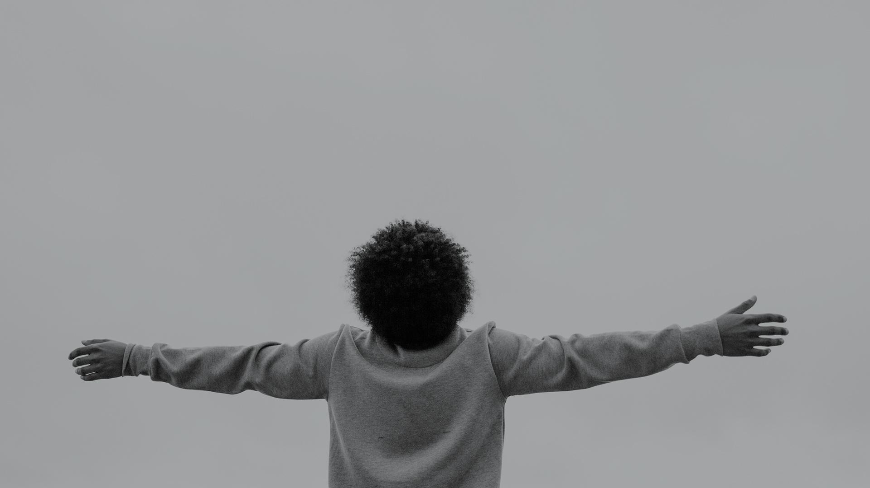
when?
Black Lives Matter (BLM), international social movement, formed in the United States in 2013, dedicated to fighting racism and anti-Black violence, especially in the form of police brutality.

Slide 7
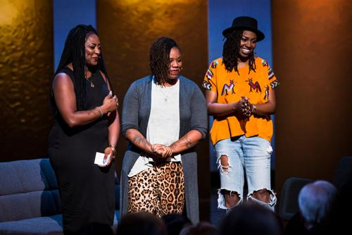
Who started blm?
BLM was cofounded in 2013 as an online movement (using the hashtag #BlackLivesMatter on social media) by three Black community organizers
Alicia Garza
Patrisse Khan-Cullors
Opal Tometi

Slide 8
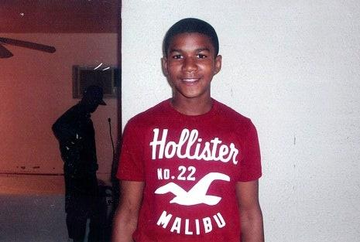
Why blm has started?
They formed BLM after George Zimmerman, a man of German and Peruvian descent, was acquitted on charges stemming from his fatal shooting of Trayvon Martin, an unarmed Black teenager, in Sanford, Florida, in February 2012.
Zimmerman, a neighbourhood-watch volunteer, had seen Martin walking in his neighbourhood and called the police because he thought Martin looked “suspicious.”
Although Zimmerman was told not to do anything, he followed Martin, got into an argument with him, and shot and killed him.
When law enforcement arrived, Zimmerman claimed that he had been assaulted by Martin and fired in self-defense.
Trayvon Martin

Slide 9
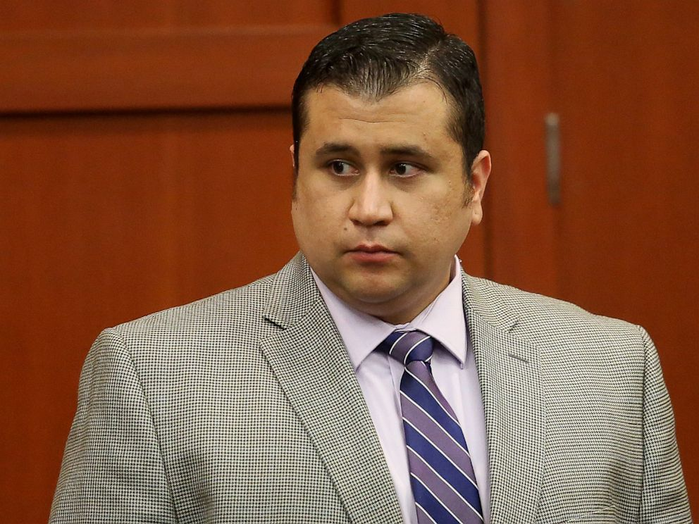
Why blm has started?
Zimmerman remained free for weeks, but, as the shooting gained national attention, demonstrations demanding his prosecution were held in cities across the United States.
He was finally charged with second-degree murder and arrested in April 2012. At his trial more than a year later, Zimmerman claimed that he had acted in self-defense, citing a controversial Florida law known as “stand your ground.”
His acquittal in July 2013 was widely perceived as a miscarriage of justice and led to further nationwide protests.
George Zimmerman

Slide 10
04
02
history
Root cause of racism-slavery

Slide 11
Black history
1793
Fugitive slave act-crime to help slave escape
1619
1861-1865
Slavery comes to North America
Civil War.186,000 black soldiers joined Union Army. 38,000 lost their lives

Slide 12
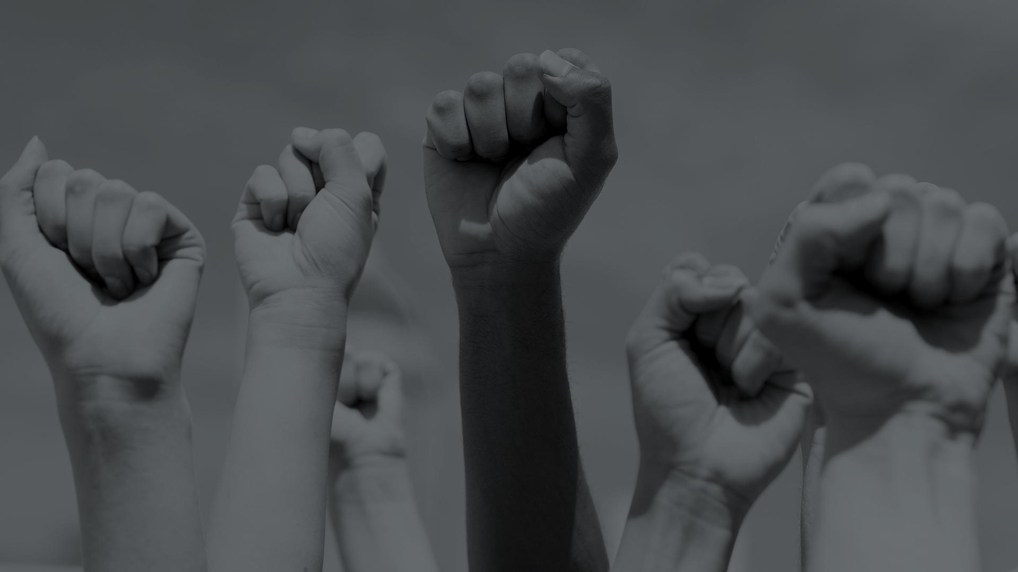
1964 Civil Rights Act

Slide 13
03
Analysis
Discrimination in various sectors

Slide 14
Sectors for comparision
HEALTH SECTOR
EDUCATIONAL SECTOR
SOCIAL SECTOR
POLITICAL SECTOR
ECONOMIC SECTOR

Slide 15
In 2012
Health Sector
Education Sector
Social Sector
In Schools 48% of black people gets suspended more than once while white suspension is only 5%
Killing rate at the hands of police is 31.17 per million for black teens and 1.47 per million for white teens
30% of African-American patients endorsed the idea that racial discrimination in a doctor’s office is common while only 7.3% of whites agreed.

Slide 16
In 2012
Political Sector
Economic Sector
1 out of 5 members of congress is black and remaining are white
For African-American children, the poverty rate was 36.7% .White children the rate was 12.3 percent.

Slide 17
Member of house ratio
80%
whites
10%
blacks
8%
Hispanics
2%
Asians

Slide 18
Black people in america
44.5 million
That’s a lot of people!
37%

Slide 19
04
04
CONCLUSION
Wrong belief

Slide 20
prevention
We can improve lives of black people by:
Education
Empathy
Giving equal opportunities to everyone
Anti-racist work

Slide 21
THANKS

